Slide 1
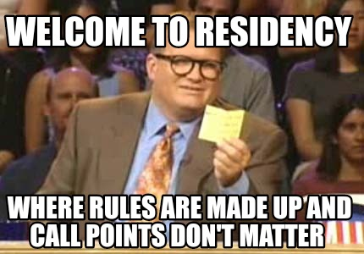

WELCOME
TO “MV ”HOTELS
BRANCH : "MV" HOTELS ROOM BOOKING
G
O
A

Slide 2
Our teammates
P . MANOHAR (24KB1A0262)
CH . SRINU
(24KB1A0213)

Slide 3
Explanation
The program defines a Room structure with the following fields:
Room ID: An integer ID for the room.
Is Booked: A boolean indicating whether the room is booked
Price Per Night: The cost per night for the room in Indian Rupees
Booked Nights: The number of nights the room has been booked for.
The displayRooms function prints out the details of available rooms, including their price per night.
The bookRoom function allows the user to book a room by entering its ID and the number of nights they wish to stay. It also calculates and displays the total cost in INR.
The displayBills function lists all booked rooms and their total bills in INR.

Slide 4
Key points
The program can handle up to “10” rooms
The prices for the rooms alternate between ₹2000 and ₹3000 to simulate different room types.
The program includes error handling for invalid room IDs and ensures that a room can only be booked if it is available.

Slide 5
Process of booking rooms
MV Hotel Room Booking System
1. Display available rooms :
2. Book a room :
3. Display booked rooms and bills :
4. Exit :
Enter your choice:

Slide 6
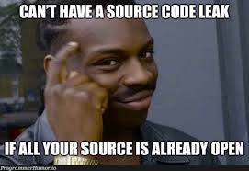
Source code
Aim : Booking a MV Hotel rooms
Description : How to book a rooms in “MV" Residency
Booking link :
https://www.programiz.com/online-compiler/02EYpbCqXfMTp

Slide 7
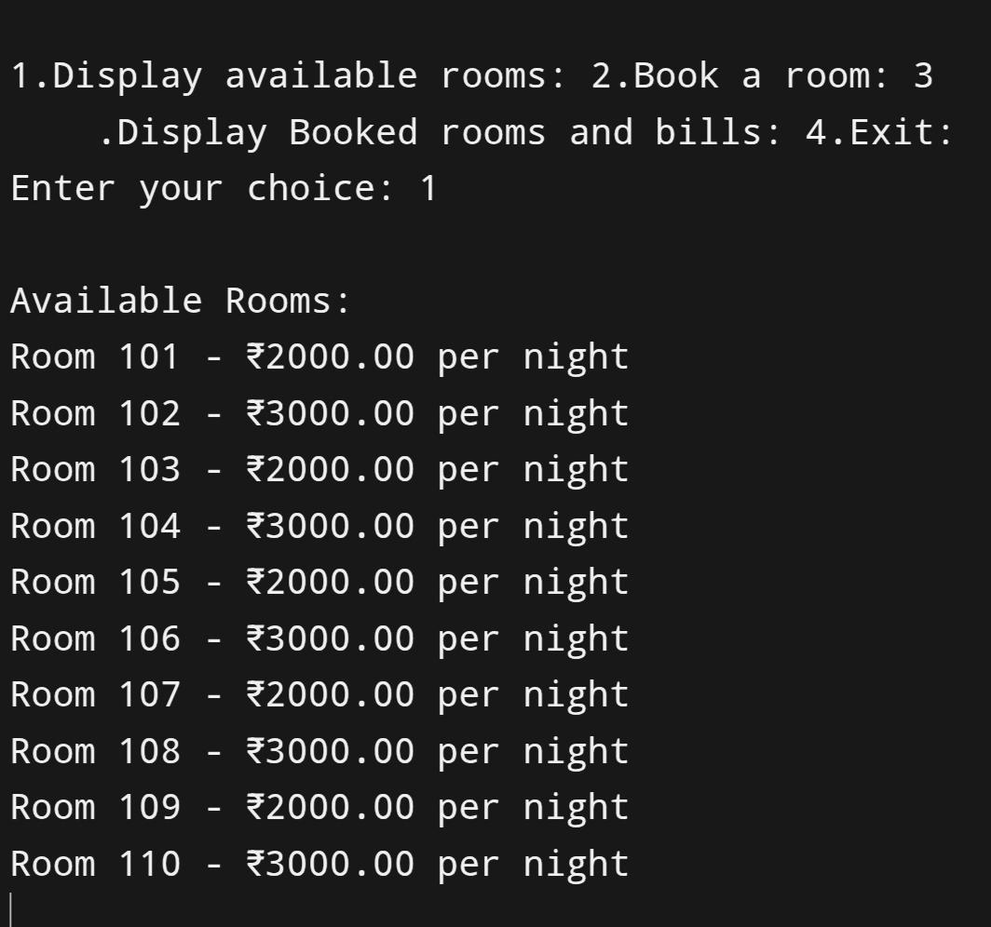

Slide 8
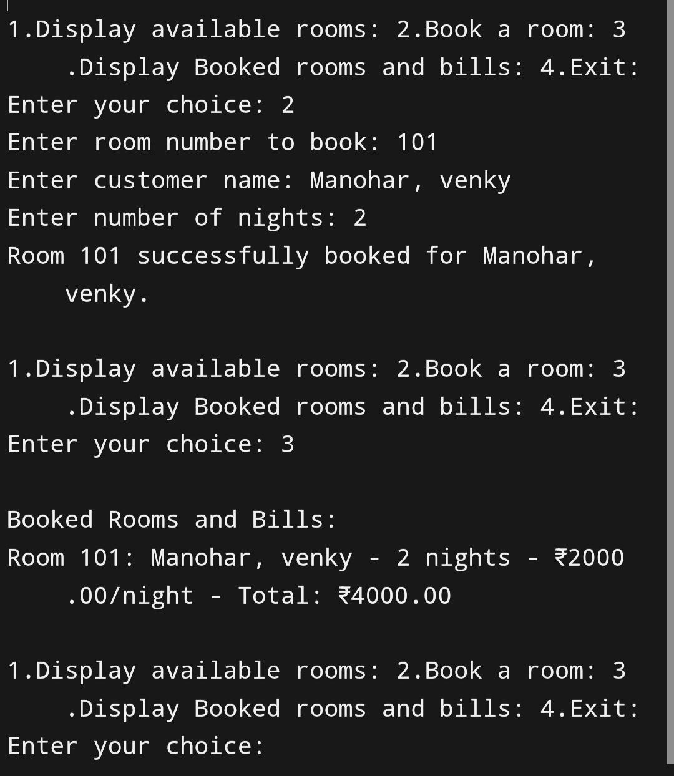

Slide 9
CONCLUSION :
The Hotel Room Booking System developed in C provides a basic yet functional console-based interface to manage room reservations. Designed to handle up to 10 rooms, this system allows users to:
View all available rooms along with their prices
Book rooms with customer details, ensuring rooms can only be booked if available
Display all booked rooms with full billing information
Show the total revenue generated from bookings

Slide 10

Thank you

